Slide 1
4
Paper Notes
Weixiao Sang
Jiaming Pan
Yazhou Li
Notes:
Hello everyone! my name is Kevin. And i am going to introduce our product it is called paper Notes it is a paper shear website.

Slide 2
01. Competitors
02. Introduction
03. Feature
04. Risk
Contents
05. Development plan
Notes:
we have 5 parts to discuss. And i will introduce the first and second parts.

Slide 3
01. Competitors
Notes:
When we read the article encounter problems, we often need to use Google to search some notes to help us, and the search results are often unsatisfactory, the notes you might find will not help you solve your problems. A lot of time was wasted. first let us see some competitors.

Slide 4

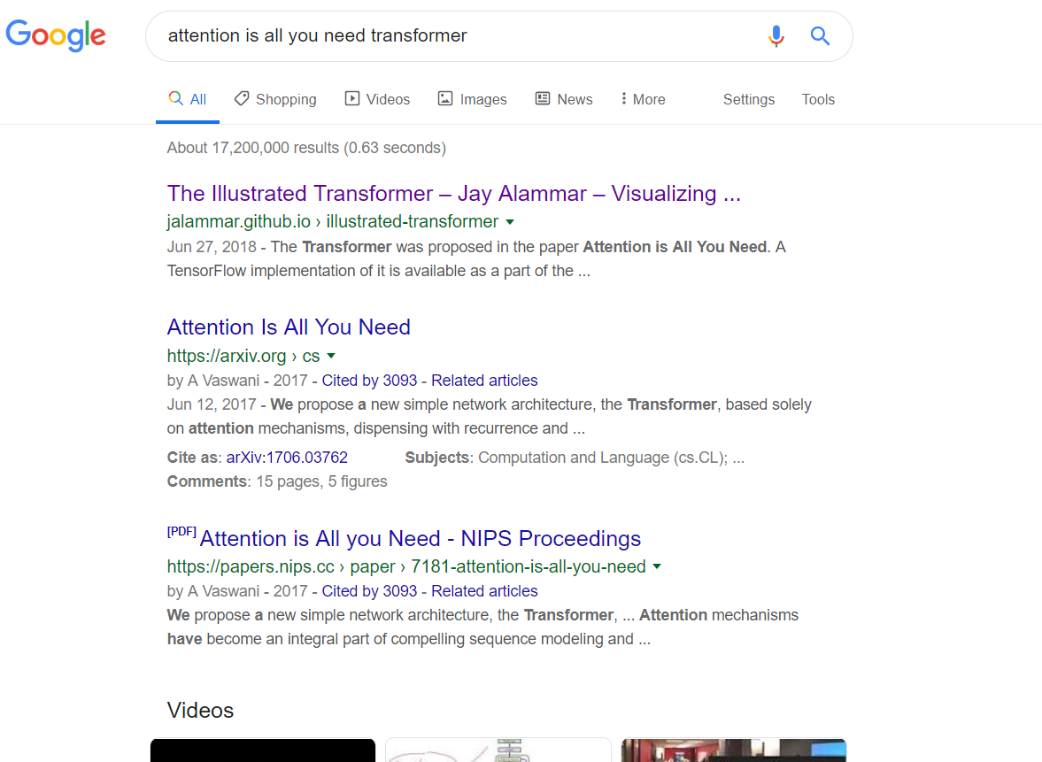
1.1 Personal blog

Slide 5
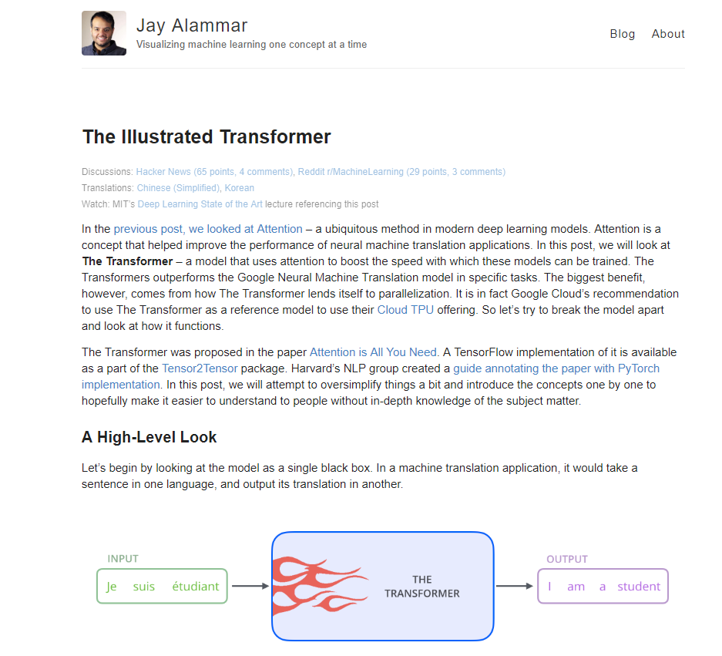
1.1 Personal blog

Slide 6
1.2 Personal blog disadvantage
1
2
User can only upload personal notes on personal blog; it is not public.
There may be more than one blog for the same paper, this makes the information very diffuse.
3
4
Different blog has different concerns about the same paper，users may not be interested in this blog.so user should search other notes.it wastes time.
User often search blog through Google and other ways,it is not efficient.
Notes:
笔记是针对整篇文章的，对一些细节可能缺乏解释。

Slide 7
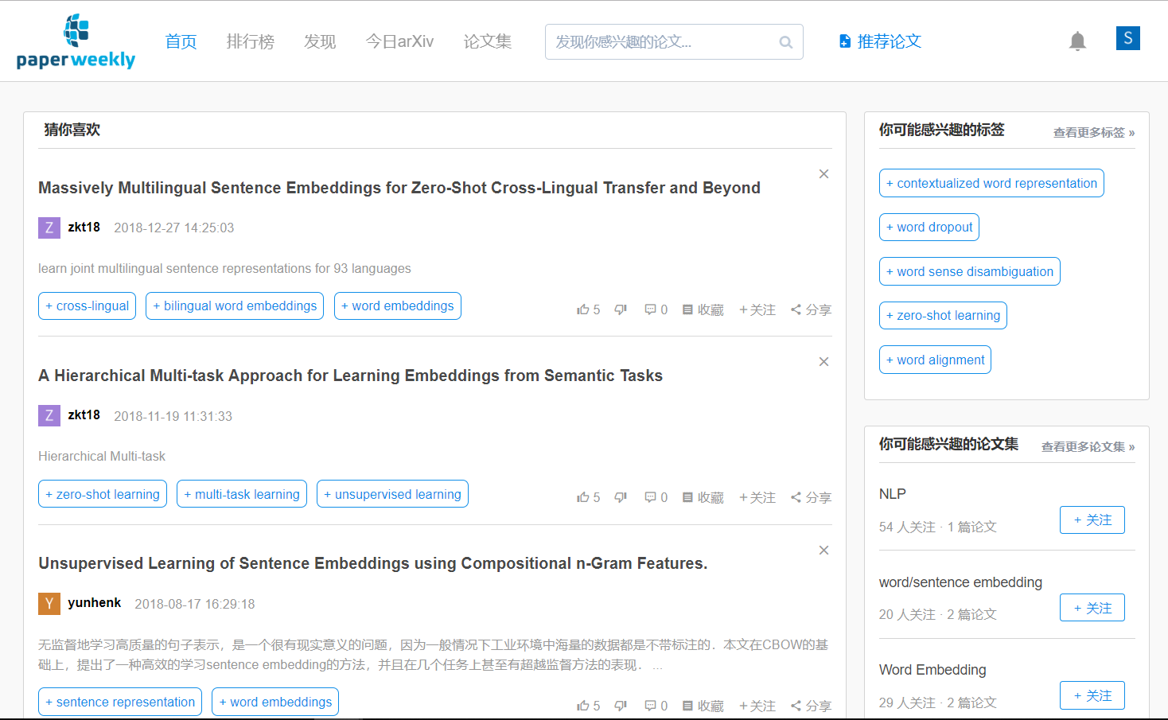
1.2 Paperweekly

Slide 8
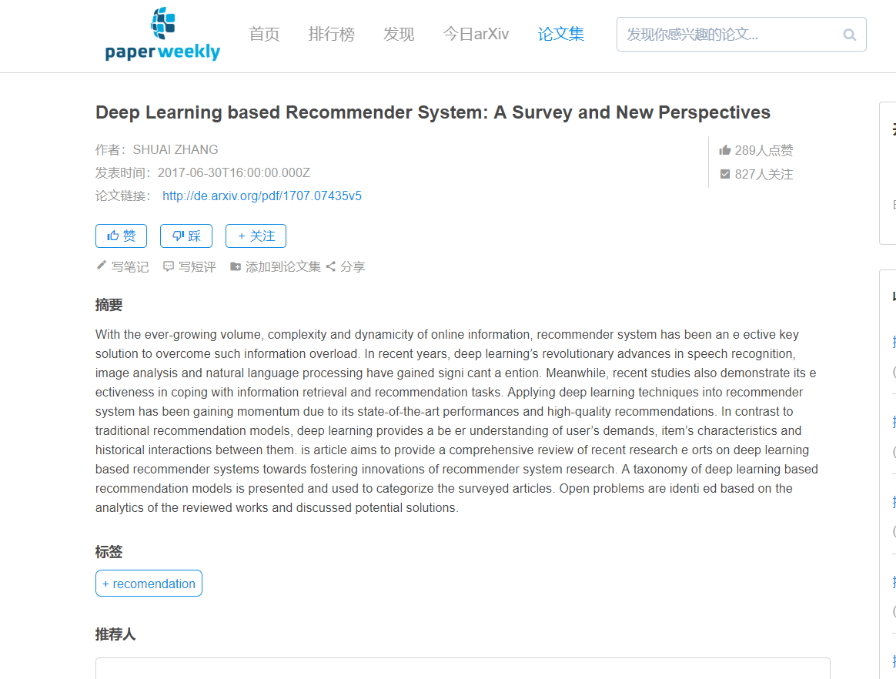
1.2 Paperweekly

Slide 9
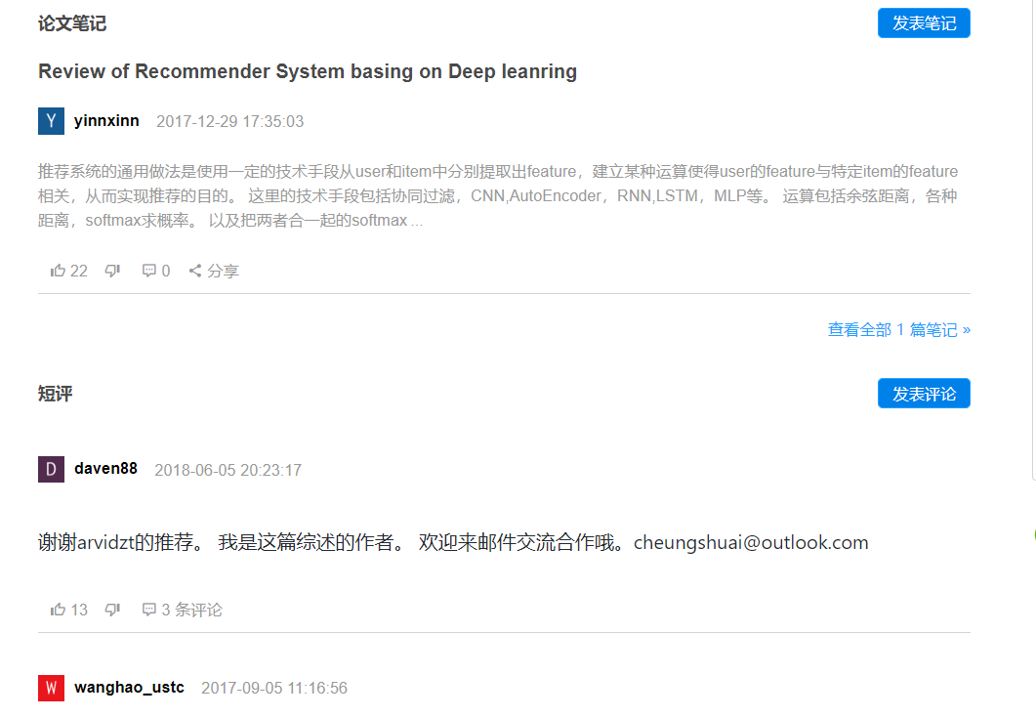
1.2 Paperweekly

Slide 10
1.2 Paperweekly disadvantage
1
2
It just provides a link of the paper. you can't read the paper directly.
The quality of notes is not good.
3
The number of users is very small

Slide 11
02.Introduction
Notes:
When we read some academic paper, we may have some parts we don’t understand, the model of author used or some ideas of user is hard to figure out, so we often need to Google some notes of others to help us understand author's thoughts, but the search results are often unsatisfactory, some paper is too new to find a note, some paper notes you find may not help you solve your problems. It makes a lot of time been wasted. So we got an idea, we want to build a website to share people’s notes where everyone can share their own notes on the same page for the same paper. When you have some parts you don't understand in the paper, you just click on it and you can see others' notes. You can also ask questions for others to answer. We hope to construct a paper sharing platform to help people read papers more efficiently.

Slide 12
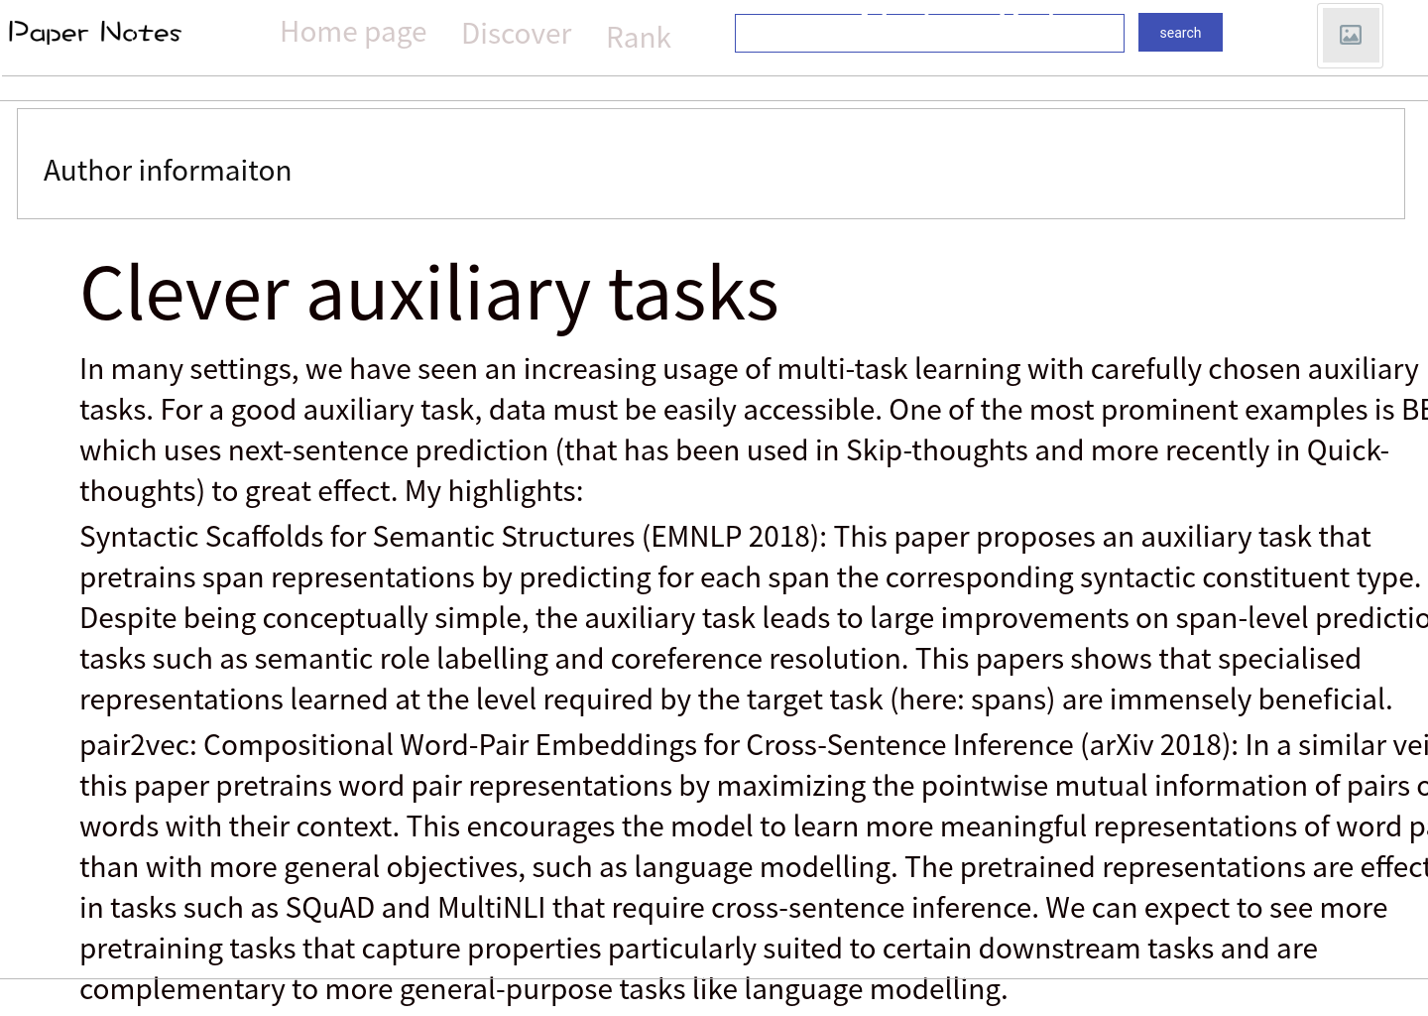
1.1 项目简介
1.1 Project description

Slide 13
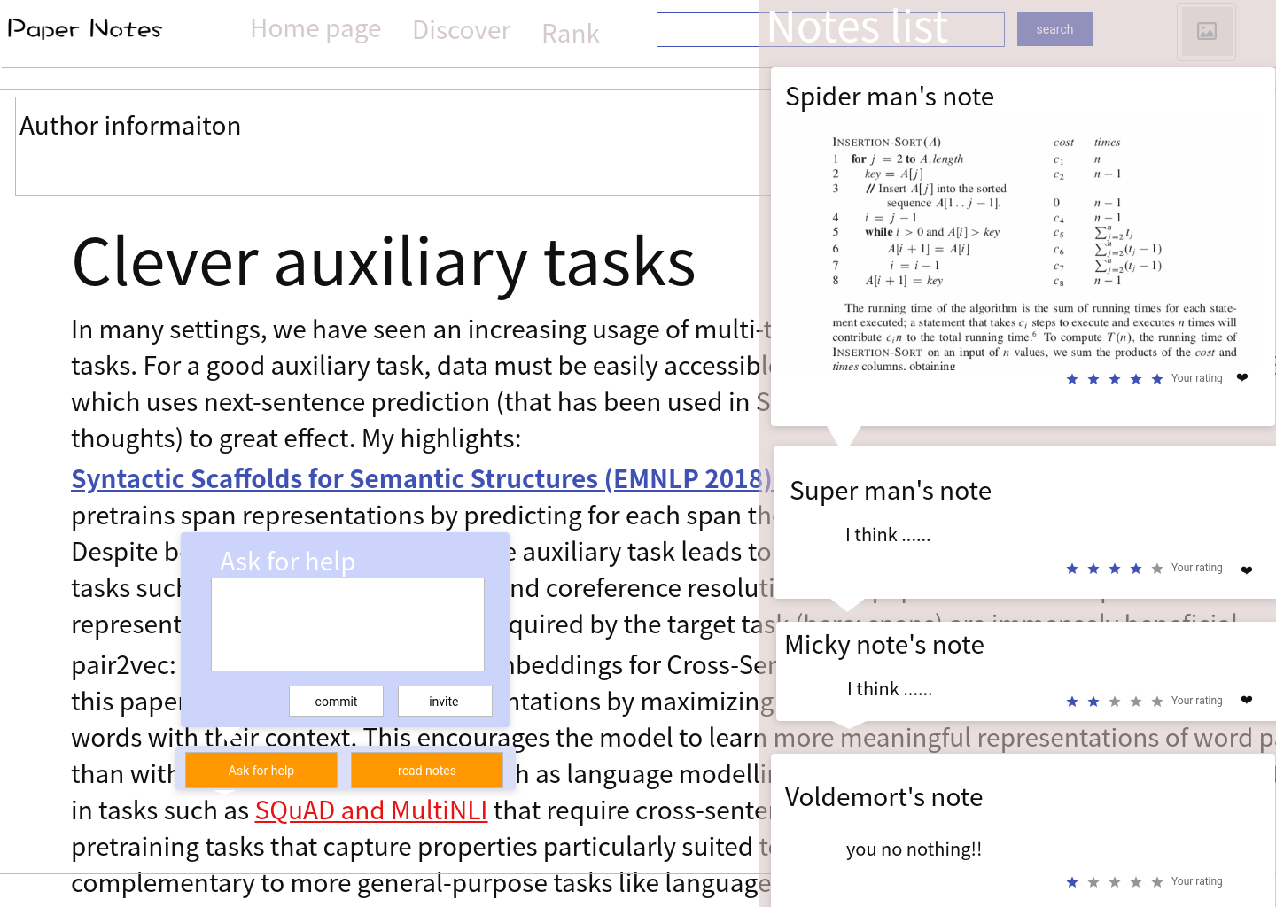
1.1 项目简介
1.1 Project description

Slide 14
1.2 Paper Notes advantage
1
2
High efficiency of reading paper
Excellent user sharing
3
High quality notes and comments

Slide 15
03. Features
01. User group
02.overall process
Notes:
First, we

Slide 16
exceptional values
1.explicit questions of what answer you want to get
2.sharing and acquire knowledge
3.Get more subscriber
and how to achieve this purpose?
user group
1.Postgraduate
2.researchers
3.developers

Slide 17
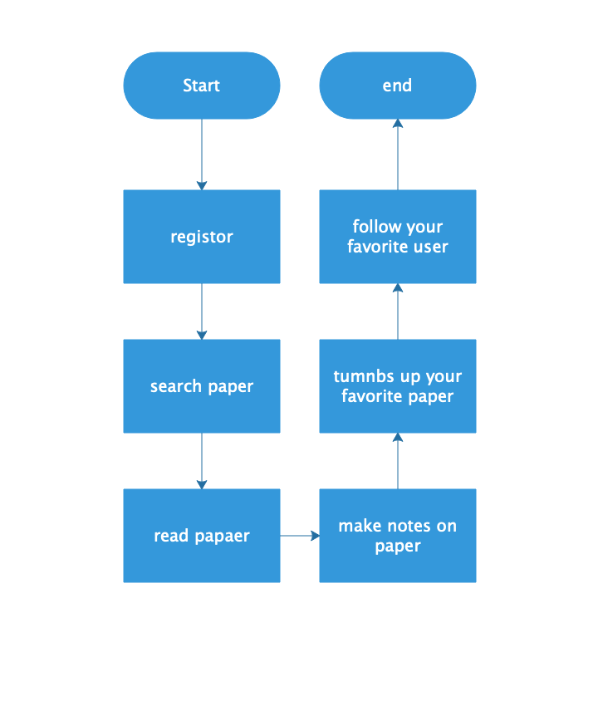
overall process

Slide 18
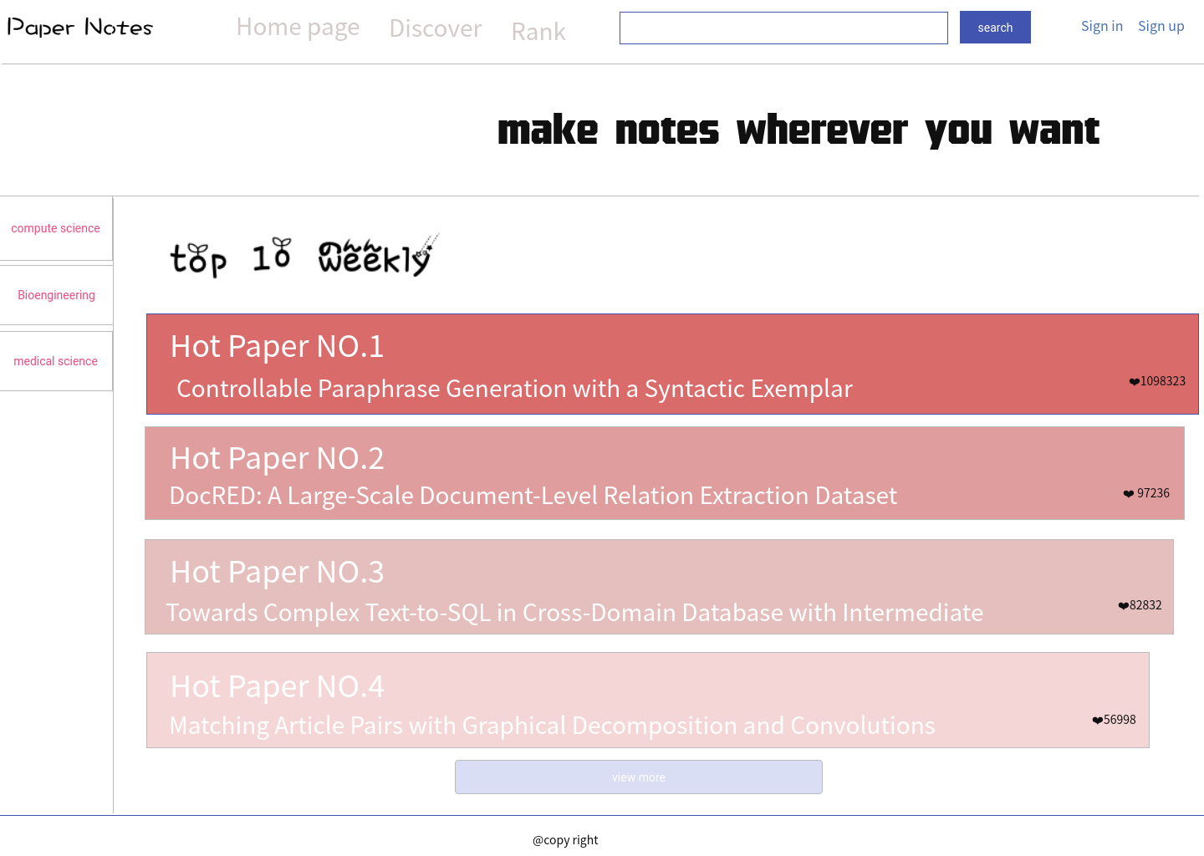
Home page

Slide 19
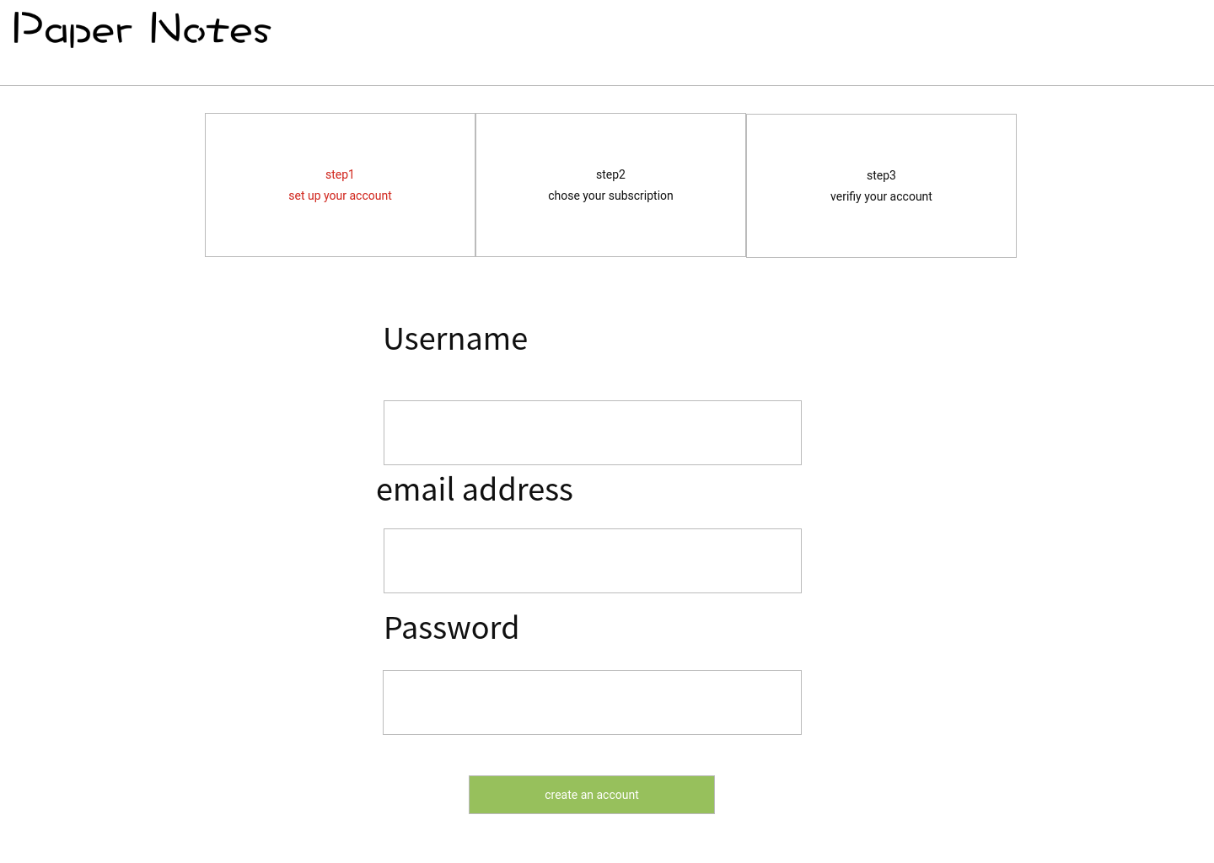
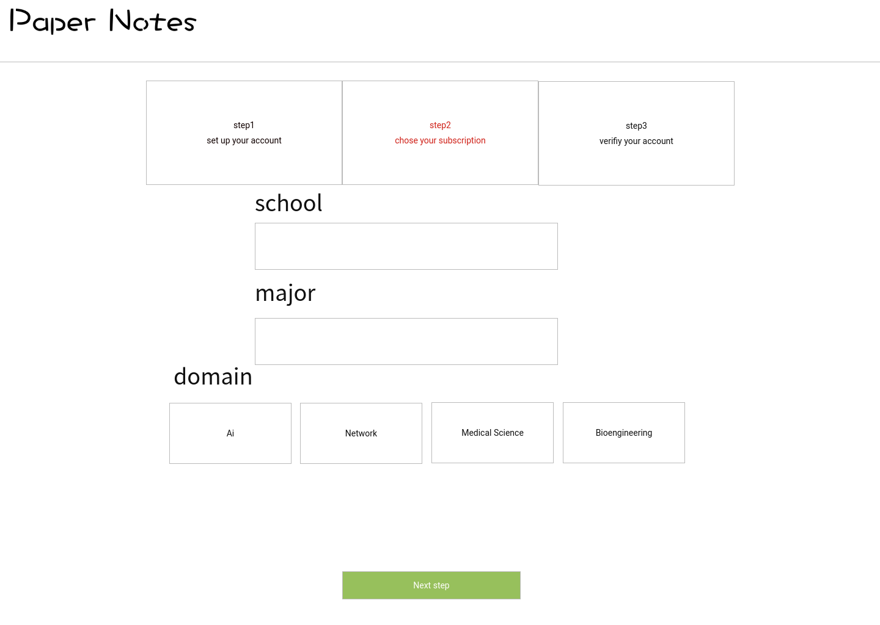
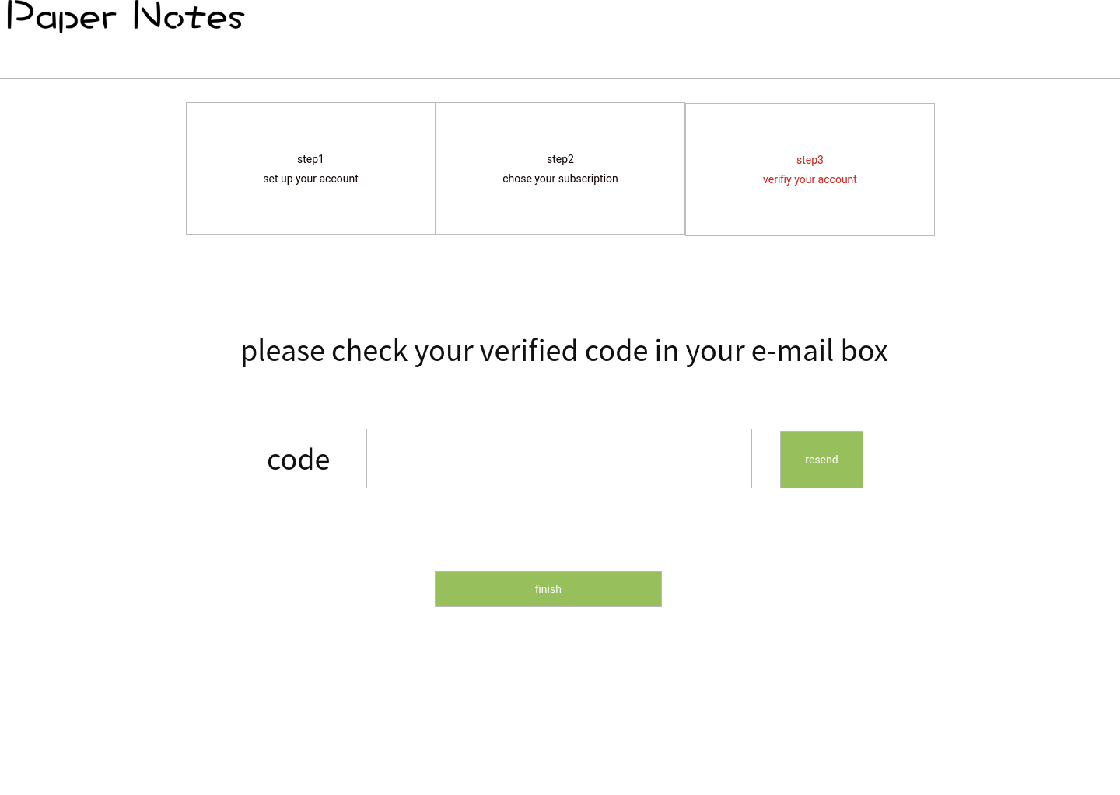
register

Slide 20
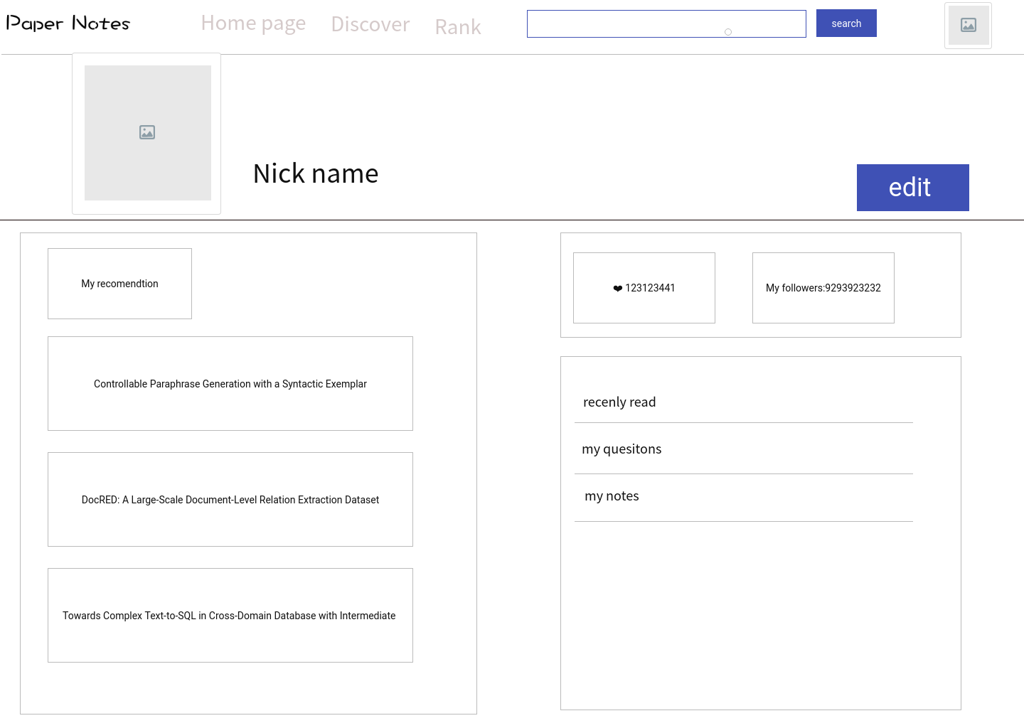
profile page

Slide 21
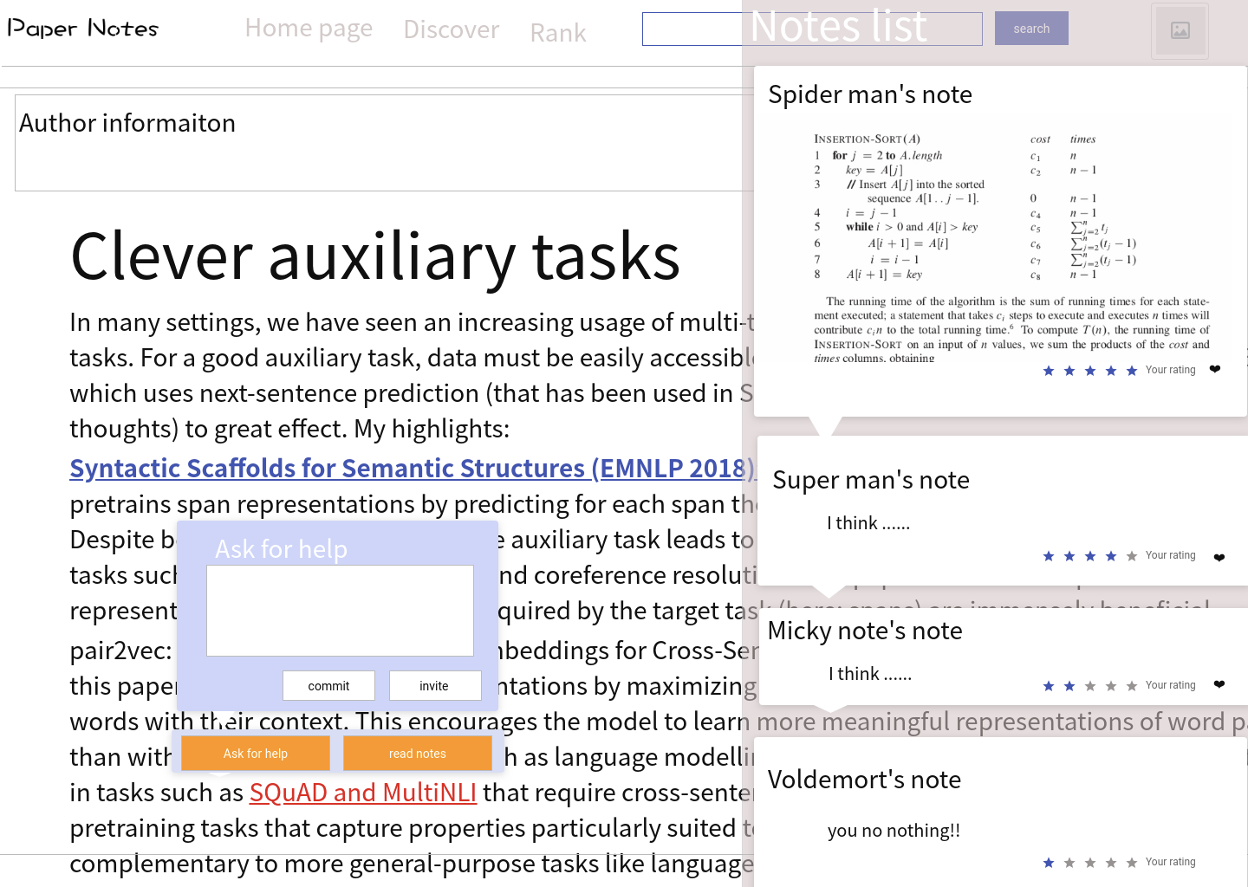
paper page

Slide 22
04.Risk

Slide 23
4.Risk
Risk | Description | Solution | Realistic probability Impact estimate(hour
Developer risk | No related technical support | Study related technology | 70%*336=84
Schedule risk | may not arrange the project reasonably | Immediate adjustment | 80%*48=38.4
Notes quality | can not guarantee the quality of notes | Sort by the quality of the comments | 30%*120=36
User number | can not get many users | Promote | 20%*168=33.6
Copyright | may not get copyright for every paper | Negotiate with related websites | 10%*240=24

Slide 24
05.Development plan
1.Tools
2.People
3.Schedule

Slide 25
5. Development Plan
Tools: Pycharm,Ideal,github,modao
People: Weixiao Sang
Jiaming Pan
Yazhou Li

Slide 26



5. Development Plan
9.9
9.13
10.15
11.18
11.30
Step 1
Step 2
Step 3
Step 4
Step 5
Finish requirements document
Build a development environment
Sign in/up,
make notes on paper
Test software availability
Recommendation

Slide 27
Q/A

Slide 28
Thanks for watching!

